Slide 1








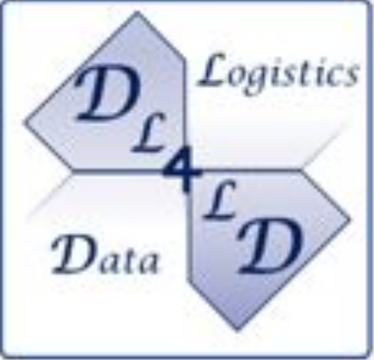

DYNAMOS: Dynamically Adaptive microservice-OS Dynamic microservices for data-exchange scenario
Master Software Engineering at the University of Amsterdam
Create ‘atomic’ microservices, to be combined for different use cases
Middleware to orchestrate services, restricted by programmable policy

Slide 2

About me
Education Master Software Engineering - University of Amsterdam (2023) Thesis: DYNAMOS, Dynamically Adaptive Microservice-based OS A Middleware for Data Exchange Systems
Work Cloud consultant – (AI) developer - devOps engineer - hotel manager Personal Born in ‘87 Lives in Utrecht

Slide 3
Data exchange marketplaces
Use cases:
SQL data analysis (hospitals, universities)
Federate Machine Learning (airlines, predictive maintenance)
Sharing anonymous sensor data (smart buildings)
AMdEX translates your data sharing agreements into machine-readable policies, that can automatically be enforced.

Slide 4
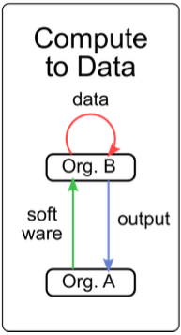
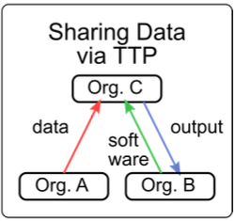
Goal
Orchestrate microservice configurations
aligned with data-sharing archetypes
Create Trust; the system will follow policy
Create algorithms to optimize on extra-functional properties (Green IT, server load, optimal archetype selection)
Self-adaptivity, deployments, archetypes and configurations can change per request
Archetypes¹
¹ Shakeri, S., Veen, L.E., & Grosso, P. (2020). Evaluation of Container Overlays for Secure Data Sharing. 2020 IEEE 45th LCN Symposium on Emerging Topics in Networking (LCN Symposium), 99-108.

Slide 5
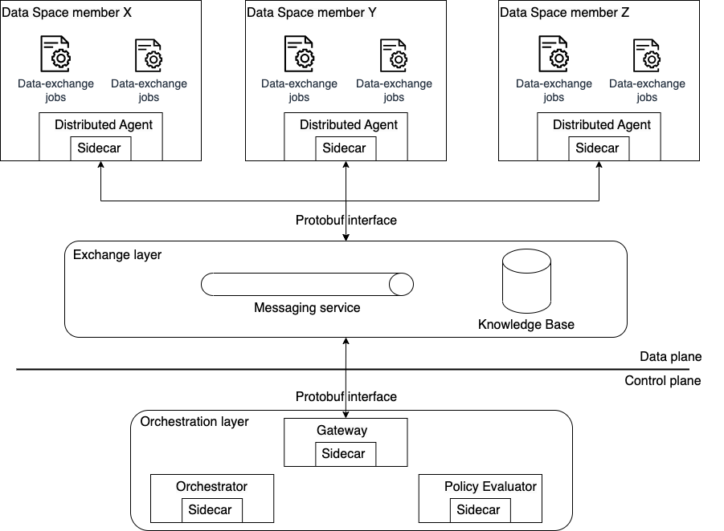

Slide 6
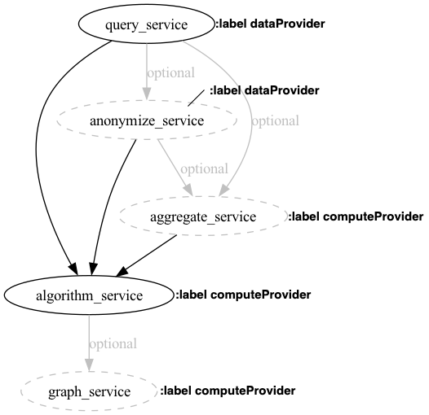

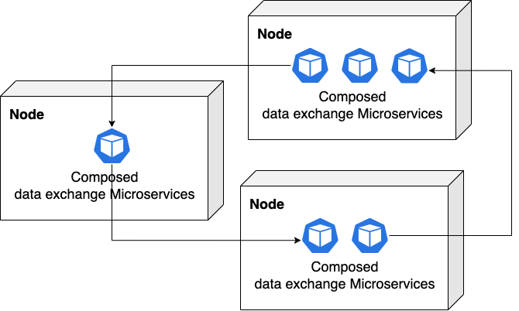
How it works
1.
Check policy and additional requirements
2. Generate microservice chain
3.
Create single-use data-exchange jobs

Slide 7






DEMO
Data
Data
Data
Data
Algorithm
Algorithm
Result
Algorithm
Result
Result

Slide 8
DEMO
Data
Data
Data
Data
Algorithm
Algorithm
Result
Algorithm
Result
Result

Slide 9
Future research
Experiment with additional data-sharing archetypes
Link Fabric into DYNAMOS
Full distributed scenarios
Sharing large dataset
Bring the control plane into the network
Notes:
"Can you elaborate on how DYNAMOS dynamically generates microservice compositions in response to changing data exchange policies or user demands, and what benefits this offers over static configurations?” The microservices are generated based on a preset IO configuration. Based on this, environmental information, and possibly request information an DAG or microservice chain is generated. The advantage is that functionality can be changed dynamically without developer intervention when agreements change and the system can take decisions on optimal selections.
“Given DYNAMOS's emphasis on programmable policy for data exchange, how does the system effectively enforce security and compliance across dynamically composed microservices The microservices themselves can be audited and signed. The programmable policy part is a full reseach branch within the UVA. Furthermore, we are in the process of writing a paper to see if we can do MBT on dynamic microservices.

Slide 10
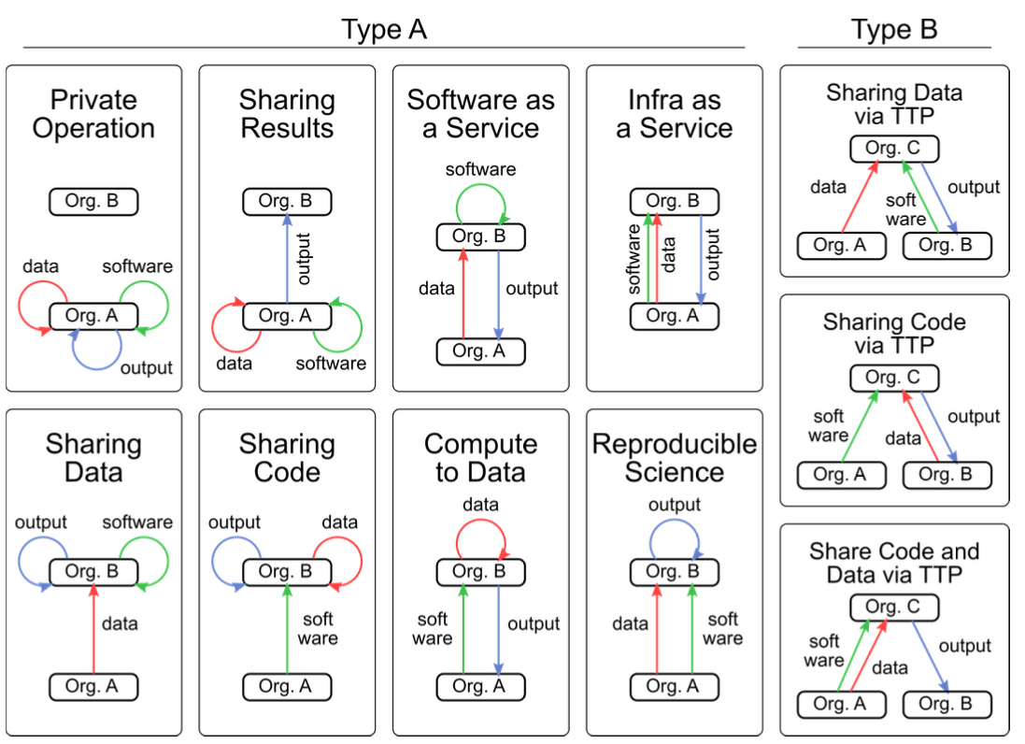
How to use
*
1.
Install or clone DYNAMOS profile
2.
Clone DYNAMOS
3.
Start experiments
* Shakeri, S., Veen, L.E., & Grosso, P. (2020). Evaluation of Container Overlays for Secure Data Sharing. 2020 IEEE 45th LCN Symposium on Emerging Topics in Networking (LCN Symposium), 99-108.

